Slide 1
MapReduce: Simplified Data Processing on Large Clusters
Jeffrey Dean and Sanjay Ghemawat

Slide 2
Introduction
MapReduce is a programming model and an associated implementation for processing and generating large data sets.
Many real world tasks are expressible in MapReduce model.
Programs written in this functional style are automatically
parallelized and executed on a large cluster of commodity machines.

Slide 3
Introduction
MapReduce computation allows:
1- Partitioning input data.
2- Handling parallelization in a simple way.
3- Scheduling the program’s execution across set of machines.
4- Managing required intercommunication between machines.
5- Handling machines failure.

Slide 4
Programming Model
Map: Takes input data and processes it to produce key/value pairs.
Reduce: Takes key/value pairs then combines them to produce final results.
Reduce is always performed after Map.

Slide 5
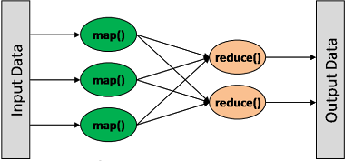
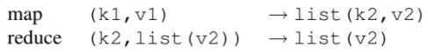
Programming Model

Slide 6
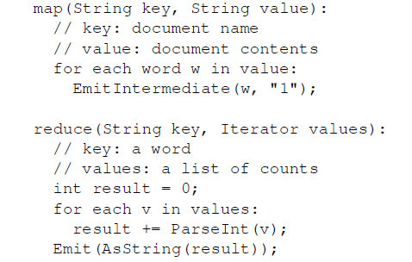
Example 1 Word count

Slide 7
More Examples
Distributed Grep
Count of URL Access Frequency
Distributed Sort

Slide 8
Solution: Count of URL Access Frequency
Map:
Processes logs of web page requests
Output: Key/value pair (URL,1)
Reduce:
Adds together all values
Result (URL, total count) pairs

Slide 9
Implementation
The choice of the interface of MapReduce implementation is based on the environment available.
Google’s computing environment features: (2004)
System is based on large clusters of commodity PCs connected together with switched Ethernet.
Machines are typically dual-processor x86 processors running Linux, with 2-4 GB of memory per machine.
A cluster consists of hundreds or thousands of machines
Storage is provided by inexpensive IDE disks attached directly to individual machines.
Users submit jobs to a scheduling system. Each job consists of a set of tasks, and is mapped by the scheduler to a set of available machines within a cluster.

Slide 10
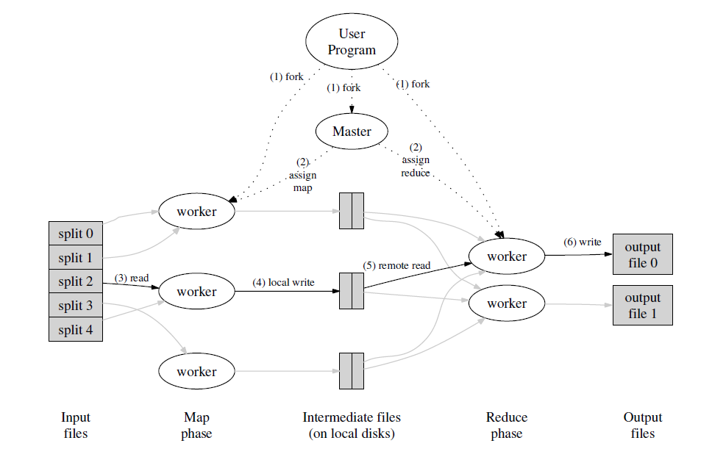
Execution Plan

Slide 11
Execution Sequence
Splits the input files into M pieces of typically 16 megabytes to 64 megabytes per piece.
Assigns the program copies to the master and the rest are workers that implement map and reduce tasks assigned by the master.
Workers implementing map tasks read input data, parse data to key /value pairs and the intermediate key/value pairs produced by the Map function are buffered in memory.

Slide 12
Execution Sequence
Buffered pairs are saved on local disk, being partitioned, then the locations of these pairs are passed to the master who is responsible for forwarding these locations to the reduce workers.
When reduce workers are notified of the locations of pairs, read the data, sort data by intermediate key.
Reduce workers iterate over the sorted intermediate data and for each unique intermediate key, pass the key and the corresponding set of intermediate values to the user's Reduce function then the function’s output is appended to the final output file.

Slide 13
Master data structures
Master keeps several data structures for each map task and reduce task, it stores state (idle, in progress, completed).
Master is responsible of data location’s propagation from map task to reduce task. So each completed map task, the master stores the locations and sizes of the intermediate file regions produced by the map task.
The information is pushed to workers that have reduce tasks.

Slide 14
Refinements
Basic functionality was sufficient in most cases
New extensions were made useful
Partitioning function
Combiner function
Input and output types
Skipping bad records
Local execution
Status information
counters

Slide 15
Partitioning function
Used to distribute intermediate keys among reduce tasks
By default, it used hashing on the whole key
Can be modified to provide better distribution
Example
Intermediate keys are URLs
We want URLs from same host to be grouped together, to be output in the same file
Define partitioning function that applies hashing on the host part

Slide 16
Combiner function
Used to “combine” intermediate keys generated of a single map task
Runs locally on the same machine the map task ran on
Example
word count
Usually, same code as reducer
Improves performance best when intermediate keys are repeated significantly
Notes:
Ya3ni lo al map btl3li word = 1 momkan map#1 ttl3 w1 = 1 20 mara we map#2 ttl3 w1 = 1 10 marat so to optimize momkan a5li map#1 ttl3 w1 = 20 we map#2 ttl3 w1 = 10 3la tol we b3den da yro7 lel reducer

